Slide 1
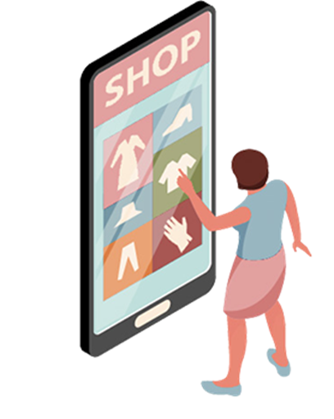
ShopBag Ecommerce Application
Software Architecture and Development
Participants:
Ketan Darekar
Gayatri Samal
Prateeksha Bheemareddy
Frank Neba Ngwa
Riya Bruhan Math
Nehal Qadeer

Slide 2
TABLE OF CONTENTS
02
03
04
TECHNOLOGIES
FRONTEND TECHNOLOGIES
APPLICATION ARCHITECTURE
06
07
08
DEMO
FRONTEND TECHNOLOGY
AUTHENTICATION, AUTHORIZATION & ROLE
01
INTRODUCTION
05
BACKEND TECHNOLOGIES

Slide 3
INTRODUCTION
We developed an E-Commerce website offering a variety of products for mens, womens, and kids, including shirts, pants, watches, and shoes. Customers can browse all products on the front page, view detailed product information, and filter items by category. They can add desired products to their cart and complete purchases through a secure payment system. Our site aims to provide a seamless and enjoyable shopping experience, ensuring ease of use and security for all transactions.

Slide 4
OUR TEAM
FRONTEND
BACKEND
MEMBERS:
GAYATRI SAMAL
FRANK NEBA NGWA
RIYA BRUHAN MATH
MEMBERS:
KETAN DAREKAR
PRATEEKSHA BHEEMAREDDY
GAYATRI SAMAL
NEHAL QADEER

Slide 5
TECHNOLOGIES
FRONTEND:
ReactJS
HTML5
CSS3
BACKEND:
NodeJS
DATABASE:
MongoDB Atlas(Cloud Version), Mongoose
TOOLS:
VS Code
GitHub
Docker
MICROSERVICES:
Stripe
Firebase
Product & Order Services fetch through Backend

Slide 6
FRONTEND TECHNOLOGY SELECTION
• The declarative JavaScript framework for creating dynamic client-side applications in HTML.
• Lets us build up complex interfaces through simple components, connect them to data on back-end server, and render them as HTML.
• Made development process much smoother and easier.

Slide 7
In React, you develop your applications by creating reusable components that you can think of as independent Lego blocks. These components are individual pieces of a final interface, which, when assembled, form the application's entire user interface.

Slide 8
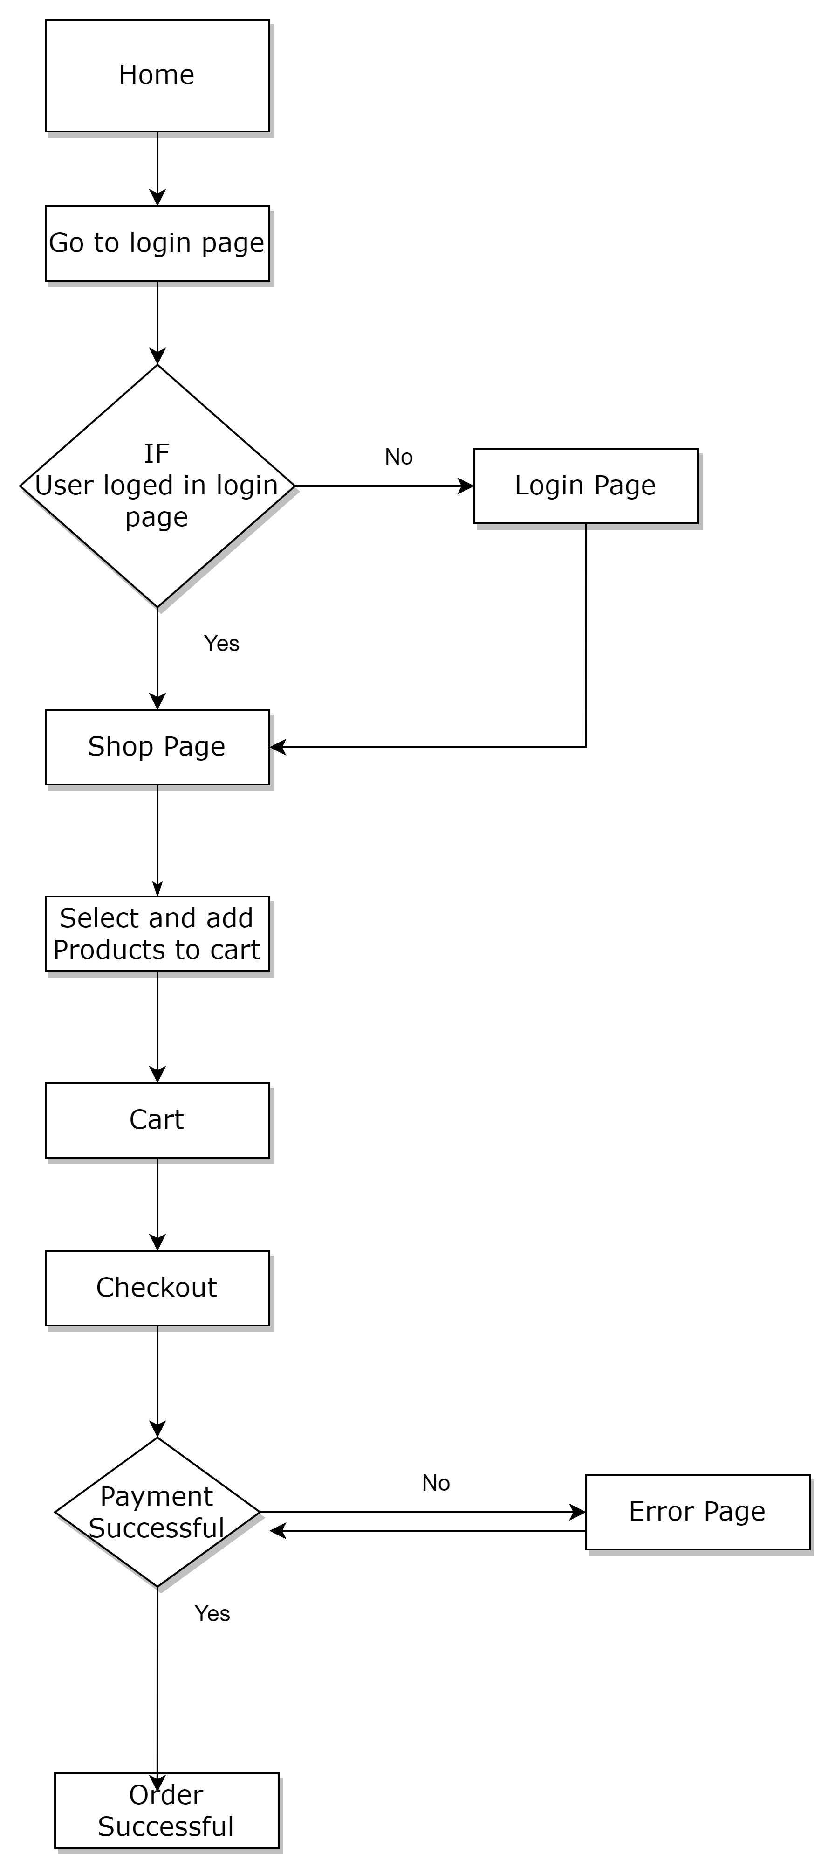
APPLICATION FLOW

Slide 9
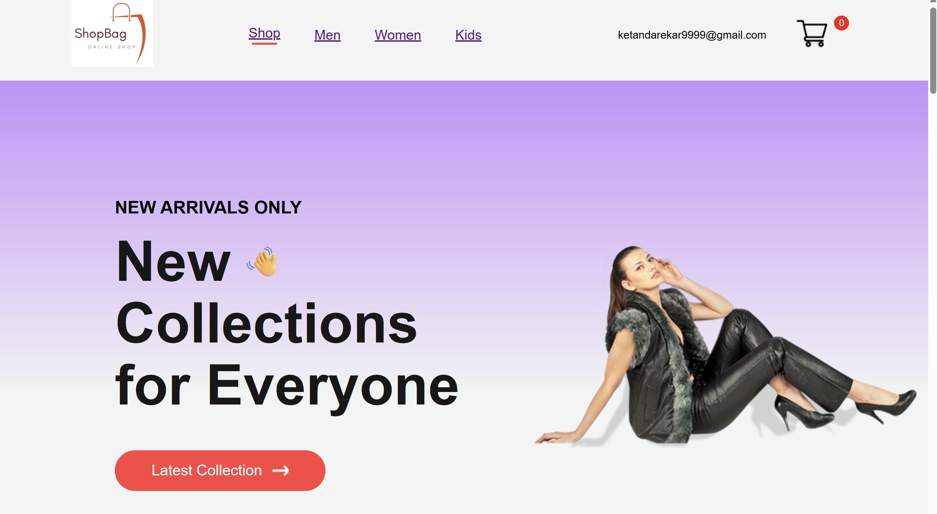
USER INTERFACE
Layout showcasing the newest and popular collections.
Navigation links to categories: Women, Men, Kids.

Slide 10
Detailed product information: images, description, price.
User interaction: Clicking on a product to view details

Slide 11
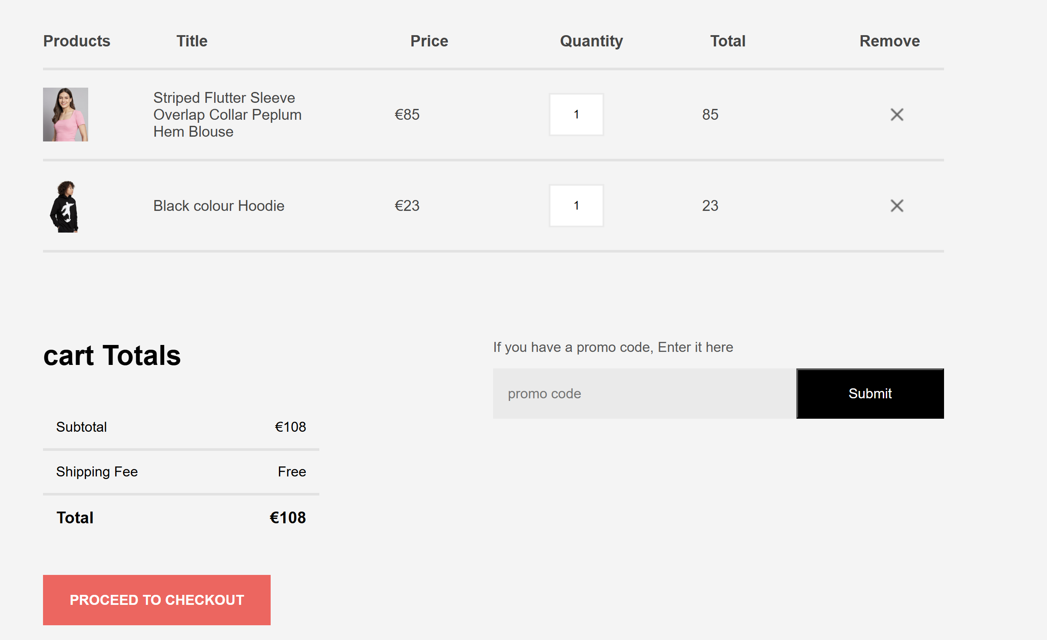
Overview of items in the cart.
Options to update remove items.
Provide the total amount of the items present in the Cart.

Slide 12
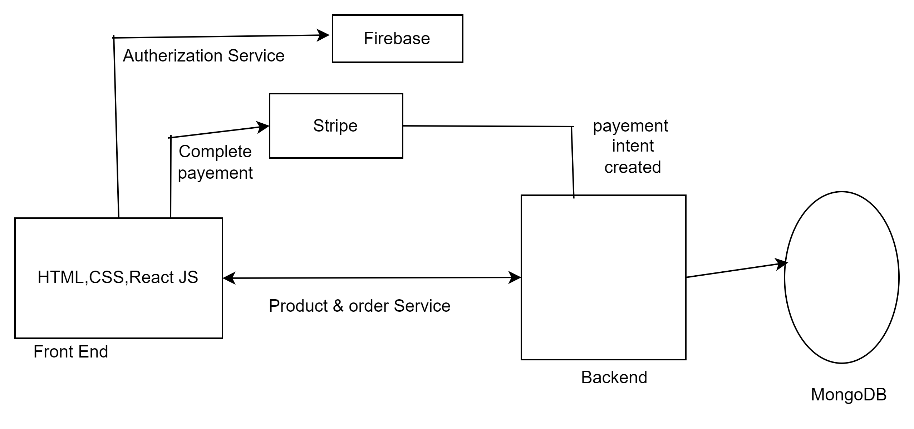
MICROSERVICES

Slide 13
BACKEND TECHNOLOGIES

Slide 14
REST APIS
As part of the REST api, we have implemented,
• Public API endpoints - accessible to all users
• Protected API endpoints - User needs to sign in/ sign up to access
• Admin Level endpoints - Accessible only to users whose role is set as Admin
We have also implemented Level 3 Hypermedia endpoint as part of our login process where the user will be presented with the next actions they can perform or parts of the application they can

Slide 15
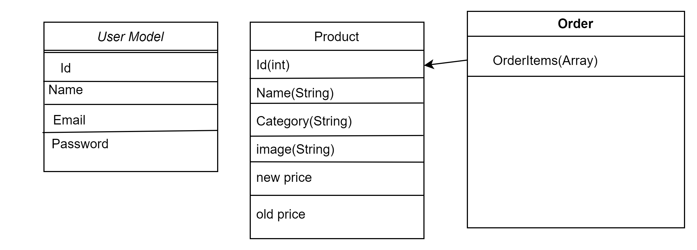

Slide 16
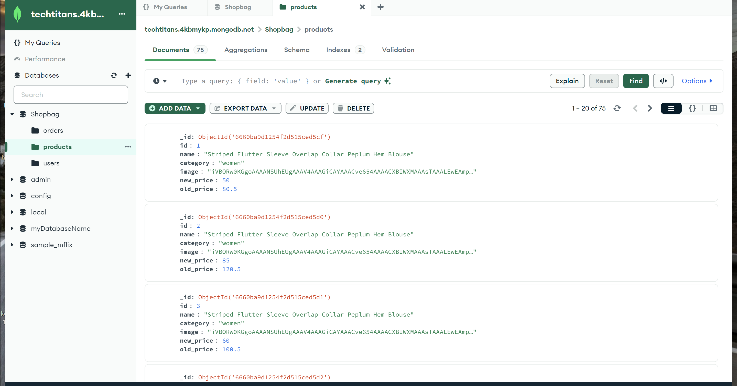
SCHEMA VALIDATION

Slide 17
DEVOPS
We have implemented the following for our deployment process,
• Docker file - Docker files setup for both frontend and backend to generates docker images
• Docker Compose - Configuration file to generate client and server docker images as part of the same workflow
• Nginx - Configuration for hosting frontend

Slide 18
SCALABILITY, REPLICATION & SECURITY
it is the most advanced cloud database service in the market with unmatched data distribution and mobility across AWS, Azure and Google Cloud. This helps us to scale the application in future if there is a need

Slide 19
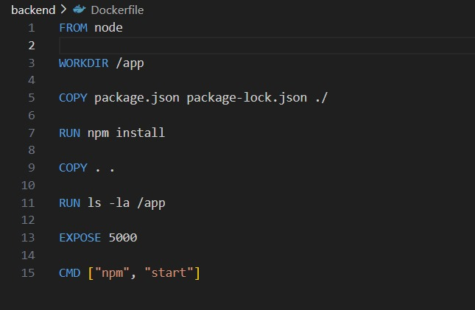
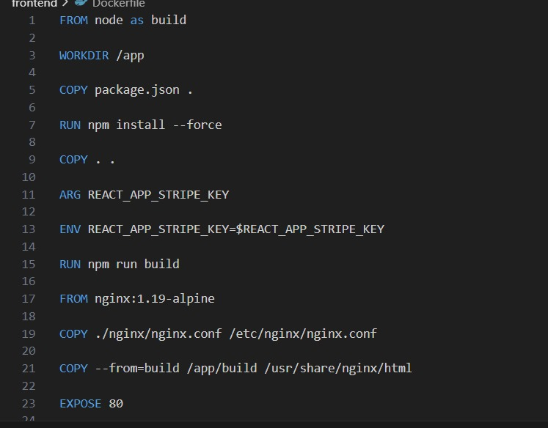
DOCKER FILE

Slide 20
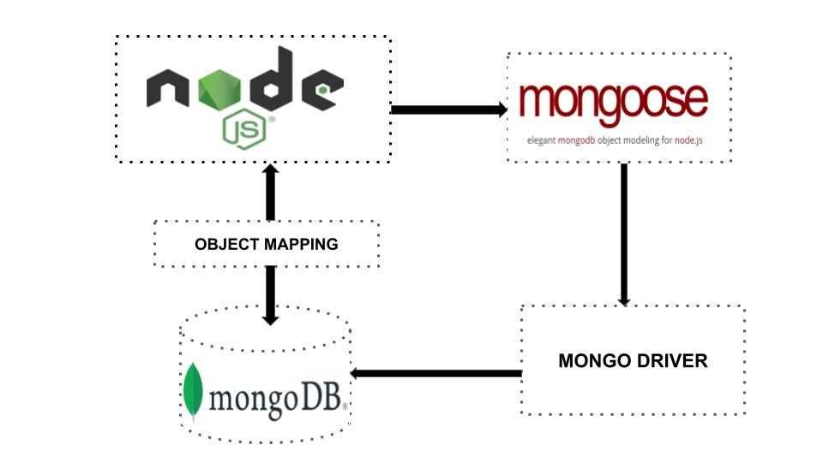
DATABASE SELECTION
Object Mapping between Node and MongoDB managed via Mongoose

Slide 21
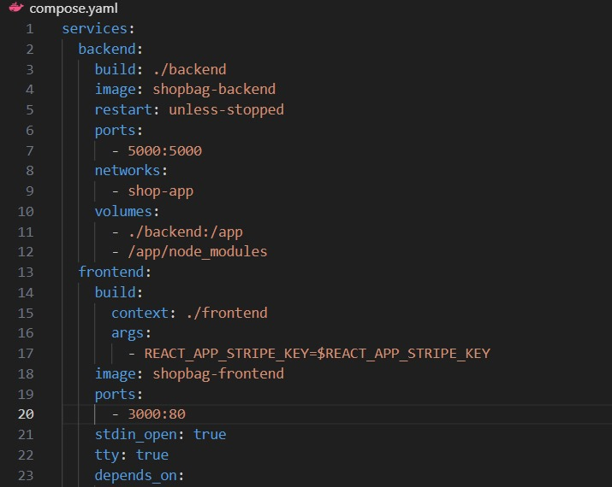
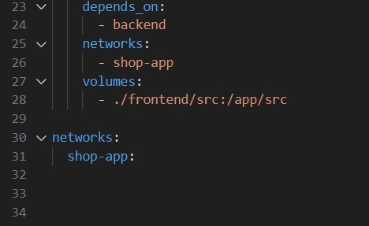
DOCKER COMPOSE

Slide 23
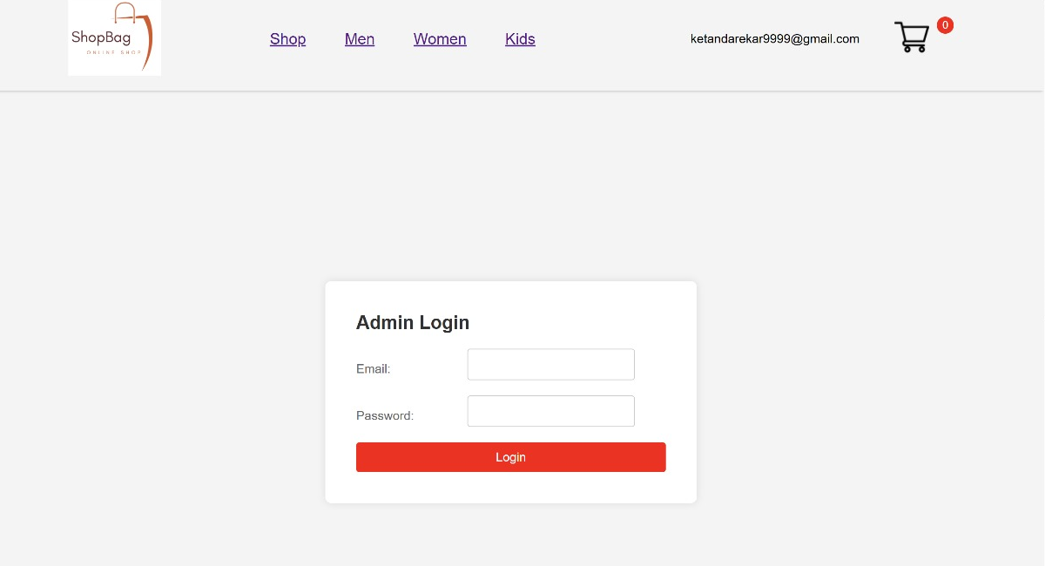
ADMIN LOGIN & DASHBOARD

Slide 24
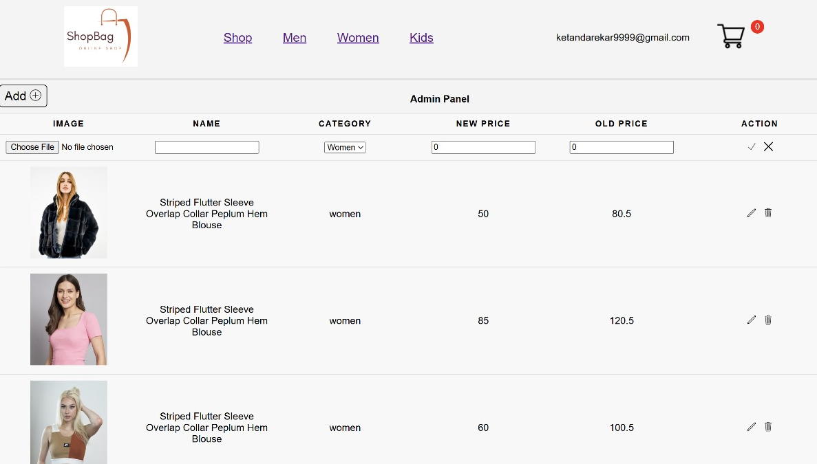

Slide 25
BACKEND OVERVIEW
KEY COMPONENTS
CODE STRUCTURE
IDENTIFY KEY COMPONENTS
API ROUTES
DISCUS THE ARCHITECTURAL PATTERN USED

Slide 26
ARCHITECTURAL PATTERN
MONOLITHIC PATTERN
User management
Product management
RESTful
Mongoose: Exemplifies the use of an abstraction layer to interact with MongoDB
Active Record pattern

Slide 27
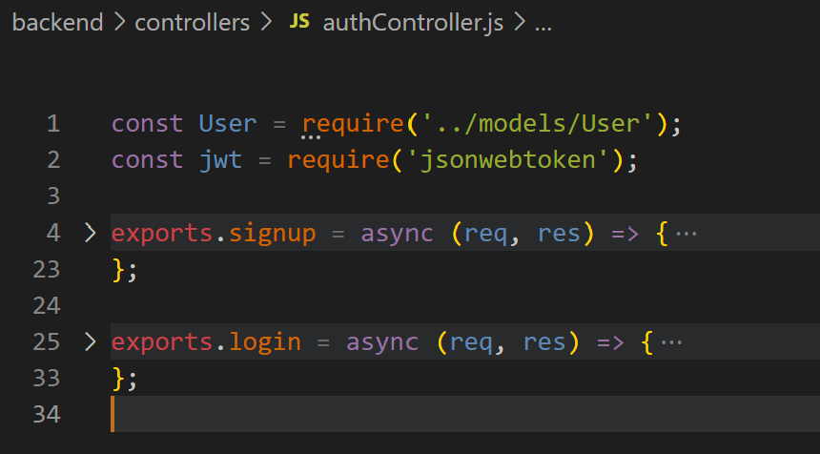
CODE STUCTURE
CONTROLLERS
AuthController
/signup: Handles user registration.
/login: Handles user login.

Slide 28
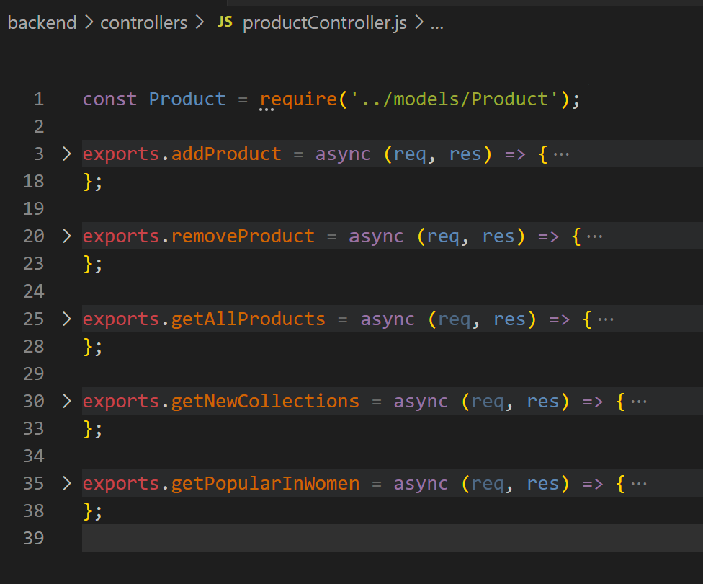
CONTROLLERS
ProductController
/addproduct: Adds a new product.
/removeproduct: Removes a product.
/allproducts: Retrieves all products.
/newcollections: Retrieves the latest products.
/popularinwomen: Retrieves popular products in the women category.

Slide 29
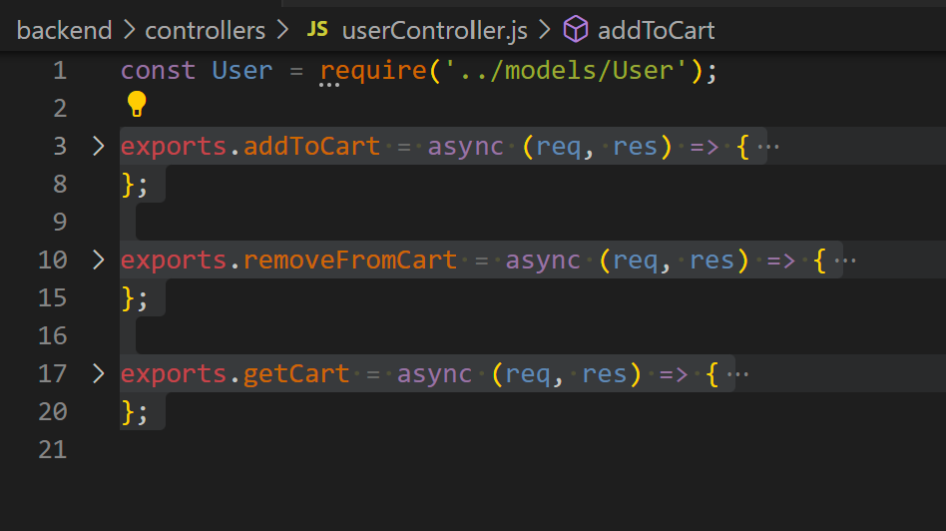
CONTROLLERS
UserController
/addtocart: Adds an item to the user's cart.
/removefromcart: Removes an item from the user's cart.
/getcart: Retrieves the user's cart.

Slide 30
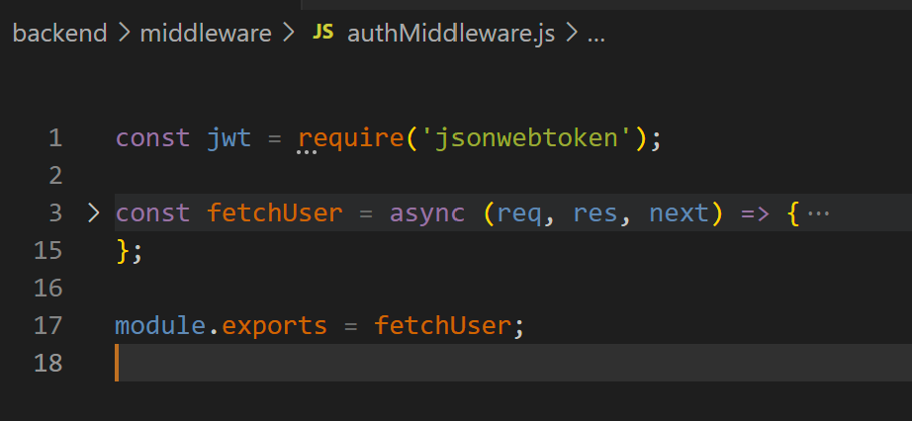
CODE STUCTURE
MIDDLEWARE
Req & Res function access.
JWT token
Ensures secure routes by verifying JWT tokens and attaching user data to requests

Slide 31
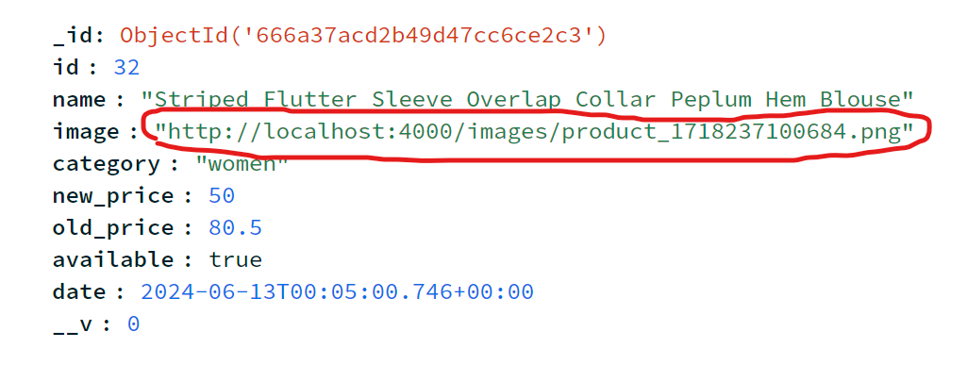
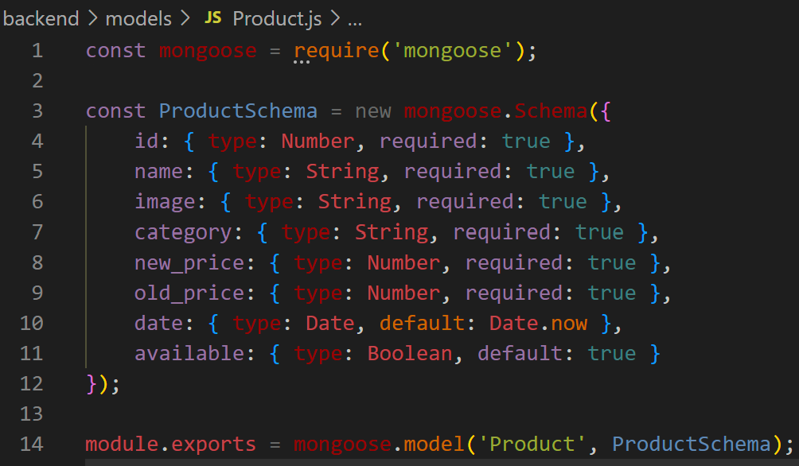
CODE STUCTURE
MODELS
ProductModel
Product structure
Handling Image

Slide 32
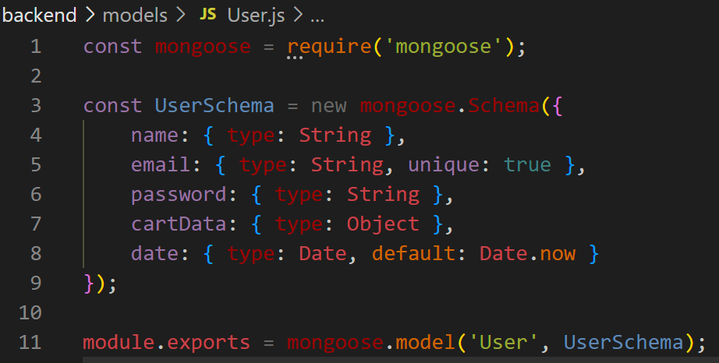
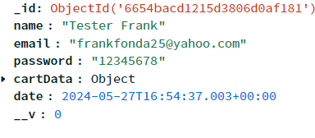
MODELS
UserModel
Notes:
DB Snippet
This Models: Define the structure and constraints of the data stored in MongoDB, facilitating data operations for users and products.

Slide 33
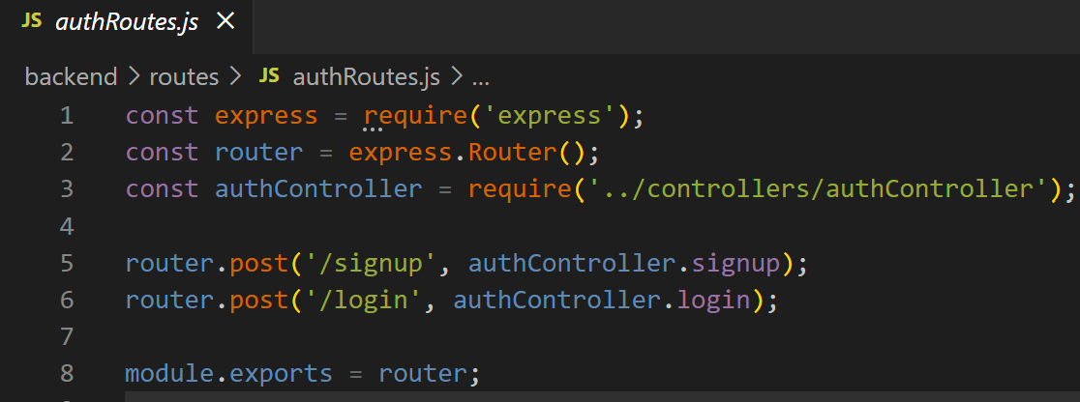
API ROUTES
AUTH ROUTE
ProductModel
POST /signup
POST /login

Slide 34
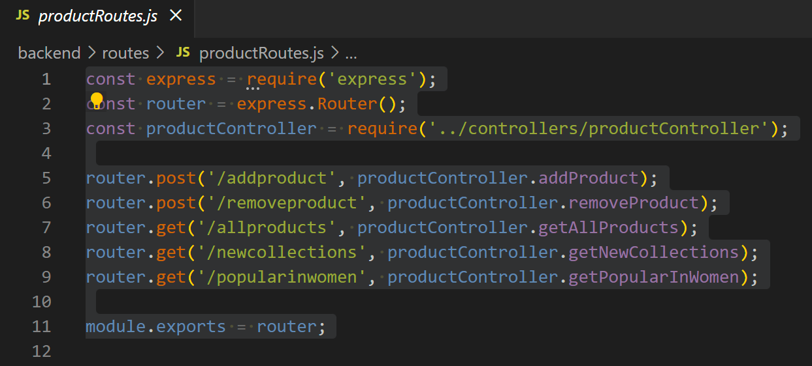
PRODUCT ROUTE
ProductModel
POST /removeproduct
GET /allproducts
POST /addproduct

Slide 35
DEMO

Slide 36
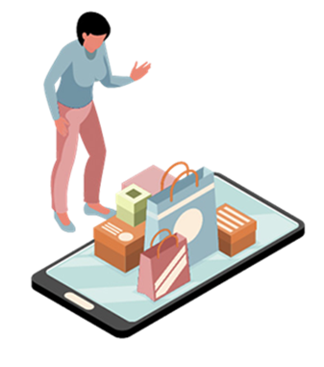
THANK YOU

